Slide 1
Snake game using Different Search Algorithms and Heuristics
—Using evaluation functions
Gagandeep KN (181IT215)
Atharv R Belagali(181IT208)
Prithvi Raj Patil (181IT234)
Prakriti Goyal (181IT233)

Slide 2
Search Algorithms used:
Breadth-first search
Best-First search
Hill climbing search
Beam Search
Tabu search
Variable Neighborhood Descent search

Slide 3
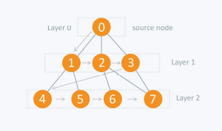
Breadth-first search
BFS is a traversing algorithm where you should start traversing from a selected node (source or starting node) and traverse the graph layerwise thus exploring the neighbour nodes (nodes which are directly connected to source node). You must then move towards the next-level neighbour nodes.

Slide 4
Best First Search
In BFS and DFS, when we are at a node, we can consider any of the adjacent as next node. So both BFS and DFS blindly explore paths without considering any cost function.
The idea of Best First Search is to use an evaluation function to decide which adjacent is most promising and then explore. Best First Search falls under the category of Heuristic Search or Informed Search.
We use a priority queue to store costs of nodes. So the implementation is a variation of BFS, we just need to change Queue to PriorityQueue Example: s->(A,C(lesser cost than B), B)->(D, E, B,C)->{B, H, E, D}->{H, E, D, F, G}
Since our goal "I" is a neighbor of H, we return.

Slide 5
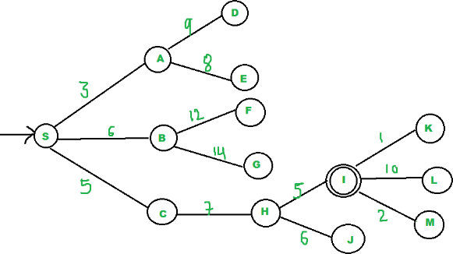
Best First Search

Slide 6
Hill Climbing Search
Hill climbing search is a local search problem. The purpose of the hill climbing search is to climb a hill and reach the topmost peak/point of that hill. It is based on the heuristic search technique where the person who is climbing up on the hill estimates the direction which will lead him to the highest peak.
Create a CURRENT node, NEIGHBOUR node, and a GOAL node.
If the CURRENT node=GOAL node, return GOAL and terminate the search.
Else CURRENT node<= NEIGHBOUR node, move ahead.
Loop until the goal is not reached or a point is not found.

Slide 7
Beam Search
Beam search is a heuristic search algorithm that explores a graph by expanding the most promising node in a limited set. Beam search is an optimization of best-first search that reduces its memory requirements.

Slide 8
Tabu search
The implementation of tabu search uses memory structures that describe the visited solutions or user-provided sets of rules.If a potential solution has been previously visited within a certain short-term period or if it has violated a rule, it is marked as "tabu" (forbidden) so that the algorithm does not consider that possibility repeatedly.

Slide 9
Variable Neighbourhood descent search
Variable Neighborhood Search (VNS),is a metaheuristic method for solving a set of combinatorial optimization and global optimization problems.
It explores distant neighborhoods of the current incumbent solution, and moves from there to a new one if and only if an improvement was made. The local search method is applied repeatedly to get from solutions in the neighborhood to local optima.

Slide 10
Domain
The Domain we chose in this task is SNAKE GAME. Snake game is a video game concept where the player maneuvers a line which grows in length, with the line itself and some mines being primary obstacles. The aim of the game is to capture as many fruits as possible without colliding with any obstacles.

Slide 11
State Space
The state space is a grid of size mxn. The snake initially is at the center of the grid, and is of length 3. The food is generated randomly in the position where the space is empty. The snake can move in all four directions, provided there are no obstacles in those directions.When the snake capture the food, the length of the snake increases by one unit, and a new food is generated randomly.
The start node is the head of the snake and goal node is the position where the food is generated. F denotes fruit, X the obstacles, O the head of the snake, 0 body of snake, and the empty spaces denote the empty states, and ‘|’ and ‘-’ denotes boundaries. The grid is printed every time the snake moves and cleared after some delay so that it creates an illusion of snake moving.

Slide 12
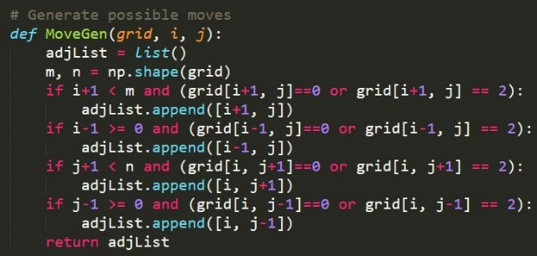
Algorithm:
MoveGen:

Slide 13

Algorithm
Goaltest:

Slide 14
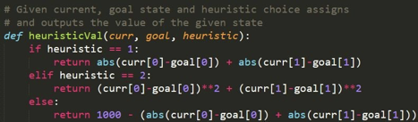
Algorithm
Heuristic functions:
curr is [x, y] tuple denoting the coordinates of head of snake goal is [x, y] tuple denoting the coordinates of fruit.

Slide 15
Best First Search Analysis:

Slide 16
Analysis of Best first search
Heuristic | Path length | Explored State | Time taken | Effective Branching Factor
1 | 48 | 115 | 0.0035002231 | 2.395
 | 37 | 98 | 0.0012042522 | 2.6486
 | 12 | 34 | 0.0004811281 | 2.833
2 | 48 | 100 | 0.0041010379 | 2.0833
 | 18 | 38 | 0.0005853176 | 2.1111
 | 23 | 46 | 0.0006804466 | 2
3 | 106 | 2397 | 0.0641703605 | 22.613
 | 134 | 2397 | 0.0466990470 | 17.888
 | 101 | 2395 | 0.0488119125 | 23.7128

Slide 17
Hill Climbing Search Analysis:

Slide 18
Hill Climbing and Best First search comparison:
A. States Explored:
The states explored in Hill Climbing search is almost always greater than states explored in Best First Search.
B. Time taken:
The time taken to find the path is greater in Best First Search than the Hill Climbing Search algo as the former takes b^d time and the latter takes constant time. But the time to reach the food is almost always is less in BFS than in HCS as the path length is less in BFS.

Slide 19
Hill Climbing and Best First search comparison:
C. Optimal Solution:
Although BFS gives a shorter path than the HCS, both the algorithms do not give optimal solution.

Slide 20
Heuristic | Hill Climbing Search | Best First Search
1 | 153 | 98
2 | 147 | 100
3 | - | 2397

Slide 21
Beam Search Analysis:

Slide 22
Beam Search analysis :
There are only three possible cases for beamwidth since the maximum branching factor is 3.
1. BeamWidth == 1: The number of explored states is less, and the solution is found in less number of cases.
Heuristic 1: The solution is found in most of the cases.
Heuristic 2: The solution is found in most of the cases.
Heuristic 3: The solution is almost never found.

Slide 23
Beam Search analysis :
2. BeamWidth==2:The number of explored states is greater than BEAMWIDTH==1, and the solution is also found in more number of cases.
Heuristic 1: The solution is almost always found.
Heuristic 2: The solution is almost always found.
Heuristic 3: The solution is found in most of the cases.

Slide 24
Beam Search analysis :
3. BeamWidth==3:The number of explored states is greater than both the above cases, and the solution is also found in more number of cases.
Heuristic 1: The solution is always found.
Heuristic 2: The solution is always found.
Heuristic 3: The solution is always found.

Slide 25
Beam length | Path | State Explored | Time Taken
3 | 48 | 210 | 0.005545139312744141
 | 43 | 192 | 0.00266170501708984
2 | 48 | 161 | 0.007121562957763672
 | 52 | 172 | 0.00863695144653320
1 | 48 | 114 | 0.003179550170898437
 | 108 | 226 | 0.00895476341247558

Slide 26
Tabu Search Analysis:

Slide 27
Tabu Tenure Value | Path length | Time taken | Frequency of getting stuck in loop
0 | 51 | 3.14881191253 | Very Often
5 | 52 | 3.2072343826293 9 45 | Often
10 | 50 | 3.1224761009216 31 | Sometimes
30 | 59 | 3.6912873982423 2 | Almost Never

Slide 28
100 | 93 | 5.0041010379791 2 | Almost Never
1000 | 106 | 5.641703605817 | Sometimes
>2500 | - | - | Always

Slide 29
Variable Neighborhood Descent vs Beam Search vs Tabu Search
1. States Explored:
The states explored is the least in Beam Search, and highest in Variable Neighborhood Descent Search. The states explored in Tabu Search is in between the other two searches. The states explored in Beam Search is significantly lower than the other two algorithms.

Slide 30
Variable Neighborhood Descent vs Beam Search vs Tabu Search
2. Path Length:
Beam Search, even though the states explored is less, almost always finds the shortest path, then comes the Variable Neighborhood Descent Search and then the Tabu Search.
3. Optimal Solution:
All three algorithms do not always find the optimal solution. But the solution of Beam Search algorithm is closer to the optimal solution than the other two

Slide 31
Conclusion:
All things considered, for this domain Beam Search tends to perform significantly better than the other two algorithms, then comes the Variable Neighborhood Descent Search algorithm and then the Tabu Search Algorithm.
Beam Search > Variable Neighborhood Descent > Tabu Search
The above is true only for the first two heuristic function. The first two heuristic functions tend to perform better than the third, so the comparisons are made only for the first two heuristic functions.

Slide 32
NOTE:
For all the analysis, grid chosen was of dimensions 50x50 with 100 obstacles placed in the grid.

Slide 33
References :
Geekforgeeks - https://www.geeksforgeeks.org/best-first-search-informed-search/
Hackerearth- https://www.hackerearth.com/practice/algorithms/graphs/breadth-first-search/tutorial/

Slide 34
References :
Springerlink -https://link.springer.com/article/10.1007/s10288-008-0089-1
University paper - https://www.cs.utexas.edu/~mooney/cs343/slide-handouts/heuristic-search.4.pdf

